Slide 1

Team Name : Code_crafters
Team members Names | Engineering Specialisation | Graduating year | College Names
K Praveen kumar | AIML | 2027 | Aditya College of Eng. & Tech.
Yash Kumar Rawate | CSE | 2027 | Aditya College of Eng. & Tech.
Gayathri Priya | CSE | 2027 | Aditya College of Eng. & Tech.
Abhijeet Kumar | CSE | 2027 | Aditya College of Eng. & Tech.
Confidential

Slide 2
About ourself
 | K PRAVEEN KUMAR | YASH KUMAR RAWATE | ABHIJEET KUMAR | GAYATHRI PRIYA
Any projects you’ve worked on | VitalAir (Predict Blindspot AQI) , Found It(Complain on loss of object) | VitalAir(Predict Blindspot AQI) , Stock Tracker (Tracking live stocks ) | VitalAir (Predict Blindspot AQI) | Road Safety (sensors in hill corners for safe journey)
Past Hackathon experiences | 🥇 1st Place – Hackathon, IIT (BHU) Varanasi Led backend development and problem-solving Experience in real-world solution design under time constraints | 🥇 1st Place – Hackathon, IIT (BHU) Varanasi Contributed to frontend design and implementation Strong teamwork and rapid prototyping experience | 🥇 1st Place – Hackathon, IIT (BHU) Varanasi Focused on research and documentation Skilled in analyzing problems and structuring solutions | SIH internal hackathon
Accolades or awards that you have received | 🥇 1st Place – IIT BHU Hackathon | 🥇 1st Place – IIT BHU Hackathon | 🥇 1st Place – IIT BHU Hackathon | NO
Other details (If any) | Certified AWS Associate | Oracle Associate certified | linkedin certified google API Javascript | linkedin certified SQL

Slide 3


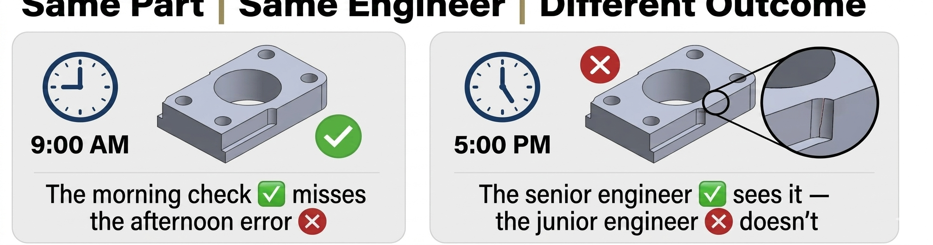
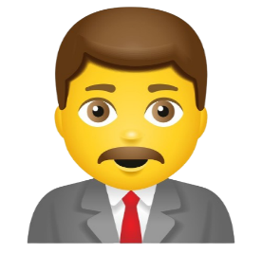
Problem Statement #9: AI-Driven Design Intelligence for Early Stage CAD
SENIOR ENGINEER
WHY CAD VALIDATION FAILS !
Human Impact
Current engineers rely on
🗹
❌ Ignore hidden inconsistencies ❌ No real-time feedback ❌ Dependent on individual expertise
I reviewed the drawing twice. Still missed the interference fit issue. Cost us 3 weeks of rework.
MANUAL
CHECKS
🔍
JUNIOR ENGINEER
One missed tolerance can be the difference between "pass" and "rework." Yet most designs get approved without automated validation.
I didn't know I violated the standard. No one told me until the design review — too late.
PROJECT MANAGER
Same Part | Same Engineer | Different Outcome
Delays keep happening because compliance issues are found at the prototype stage — every single time.
WHAT IF…
✅ Every constraint was checked in real time inside CAD? ✅ Every deviation was highlighted instantly? ✅ Every engineer had an AI assistant that never sleeps?
The Hard Truth
40% of design errors are caught after manufacturing begins
Late-stage fixes cost 10x more than catching them early
No AI assistance = blind trust in manual review
That's what we're building.

Slide 4
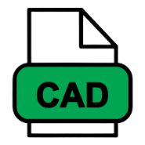
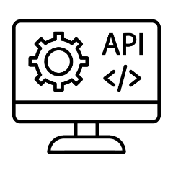
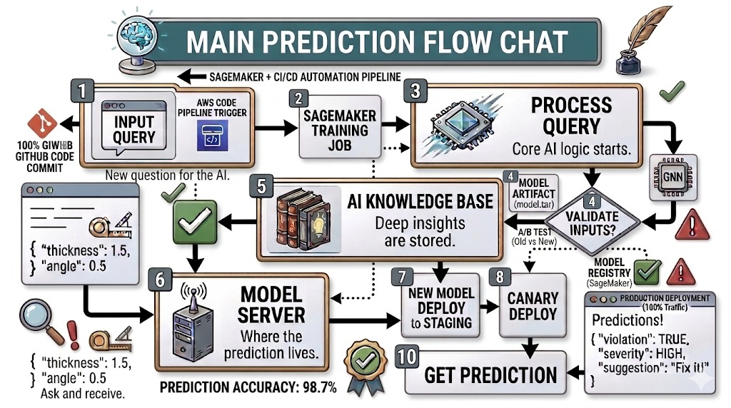
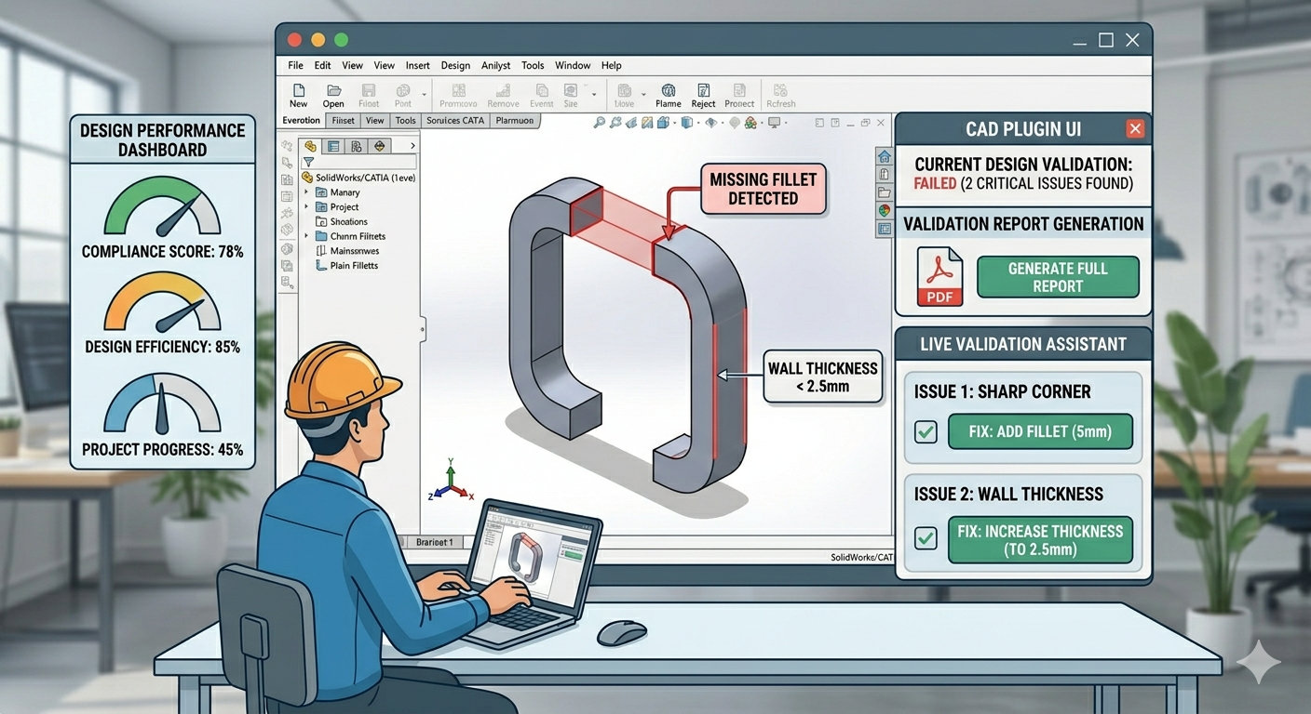


Design Details – Architecture & Approach
Catch design errors before they become expensive – in real-time, inside CAD
📊 MARKET GAP (Validated)
🔄 PROCESS FLOW
Step 1: Engineer designs in CAD
Step 2:
Plugin captures geometry
Step 3:
AI checks against ISO/company rules
Step 4:
Violations highlighted instantly
Step 5:
Fix suggestion + report generated
70% of design defects reach prototyping | 10x higher fix cost | No real-time AI solution exists for mechanical CAD
🏗️ SYSTEM ARCHITECTURE (What we WILL build)
LAYER 1: CAD PLUGIN
⚙️ WORKING PRINCIPLE
• SolidWorks API (JAVA)
• Real-time geometry extraction
• Violation highlighting on screen
CAD plugin extracts geometry data → API sends to AI engine → AI compares against 50+ design rules → Violation + fix suggestion returned in <1 second target
LAYER 2: BACKEND API
TARGET PERFORMANCE (Estimates)
• Spring Boot (Java)
• REST endpoints for validation
• JWT authentication
LAYER 3: AI ENGINE
OUTPUT
• Python Fast API (hybrid)
• Rule-based + ML classification
• Trained on CAD feature datasets
STATEMENT
LAYER 4: DATA & REPORTS
• PostgreSQL (design rules DB)
• PDF report generator
• Audit trail storage

Slide 5
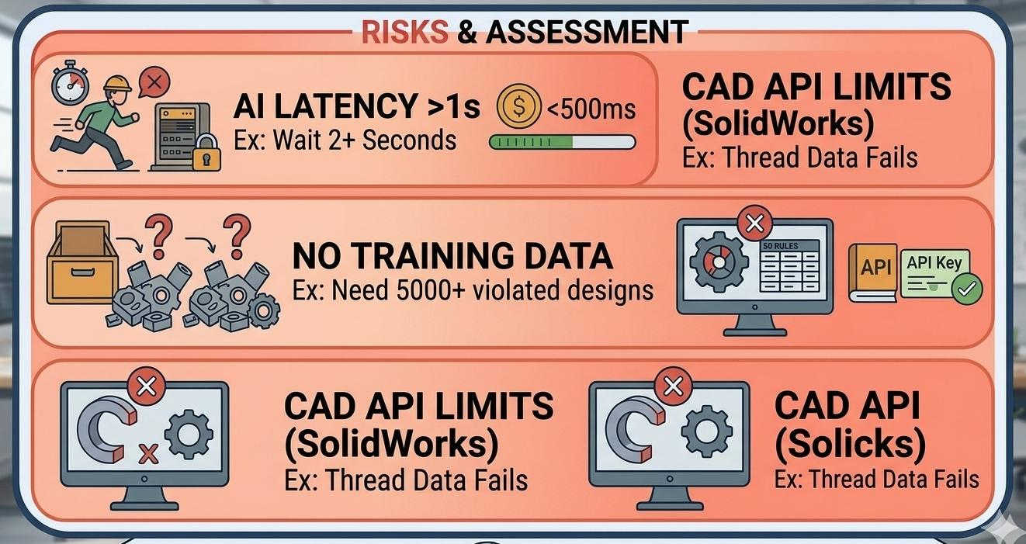
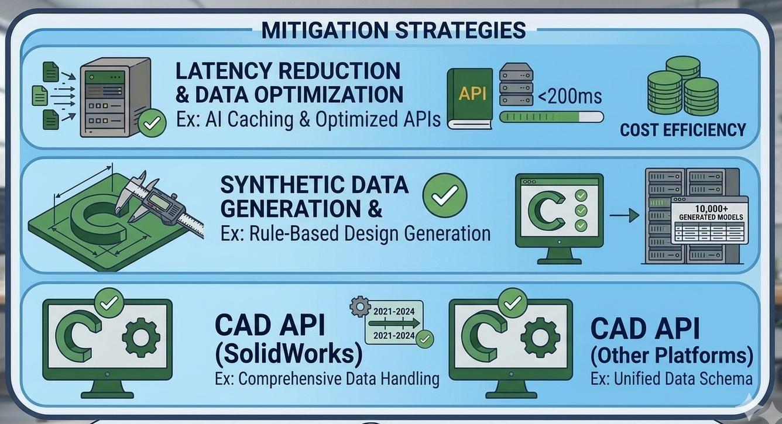
Major Risk And Mitigation
RISK (RED ZONE)
Mitigation (GREEN ZONE)
MITIGATION 1: CAD API Fallback
RISK 1: CAD API Limitations
Pre-studied SolidWorks API docs – data IS accessible.
Fallback: Batch validation mode (user clicks 'Check').
Alternative: Fusion 360 API ready.
Status: ✅ Research complete
SolidWorks API may not expose thread data. Fillet radius works but complex features could fail.
Real example: During research, we found surface loft data requires 3 extra API calls – adds 200ms latency.
RISK 2: AI Latency >1 Second
MITIGATION 2: Optimized AI Pipeline
Engineer waits 2 seconds → stops using plugin → product fails.
Real example: GPT-4 takes 2-3 seconds. Our target is <500ms using DistilBERT (40% faster).
Local caching for frequent checks.
Async processing with loading spinner.
Use DistilBERT (smaller model) → <500ms target.
Status: ✅ Architecture designed
RISK 3: No Training Data Available
MITIGATION 3: Synthetic Data Generation
ML model needs 5000+ CAD models with violations to learn from.
Real example: We generate synthetic data – take good CAD files, intentionally break dimensions, tolerances, and constraints.
Generate 10,000 synthetic CAD models with intentional violations.
Data augmentation (rotate, scale, mirror).
Rule-first MVP (no ML needed for Phase 1).
Status: ✅ Plan ready

Slide 6
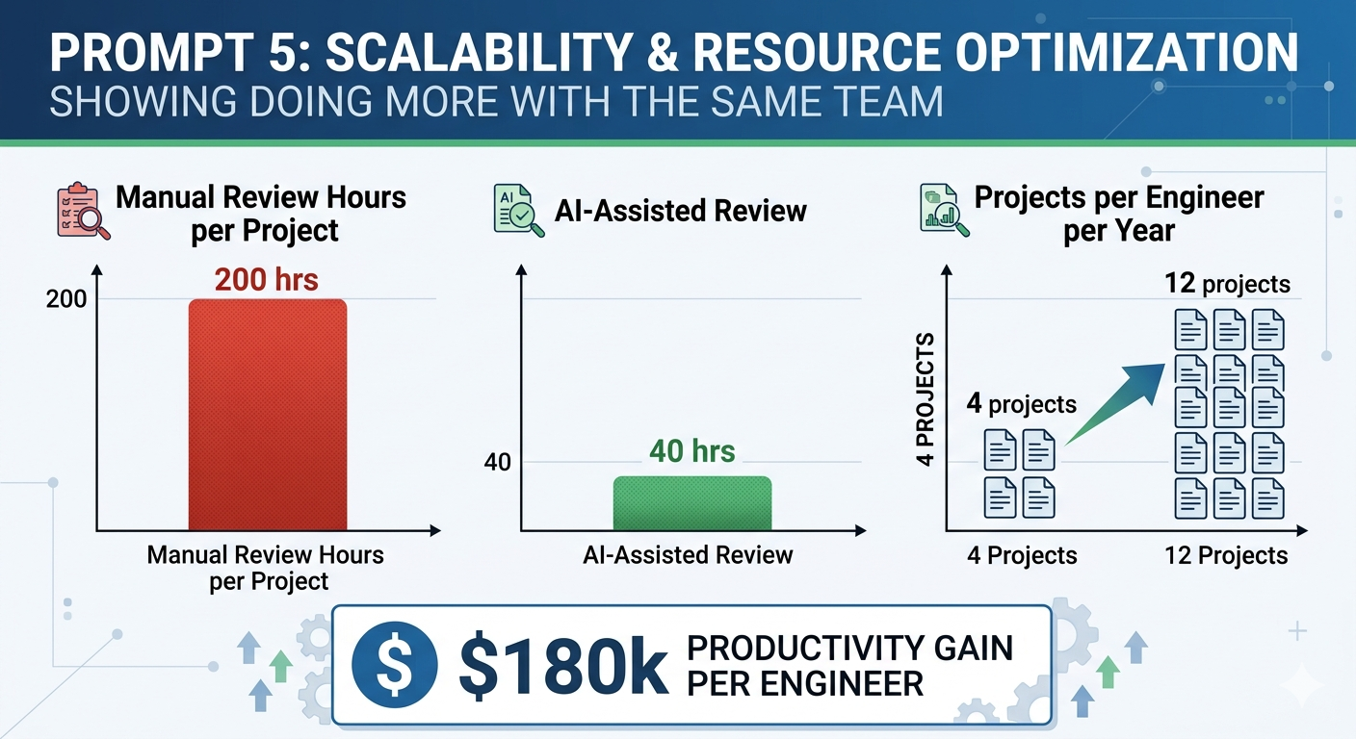
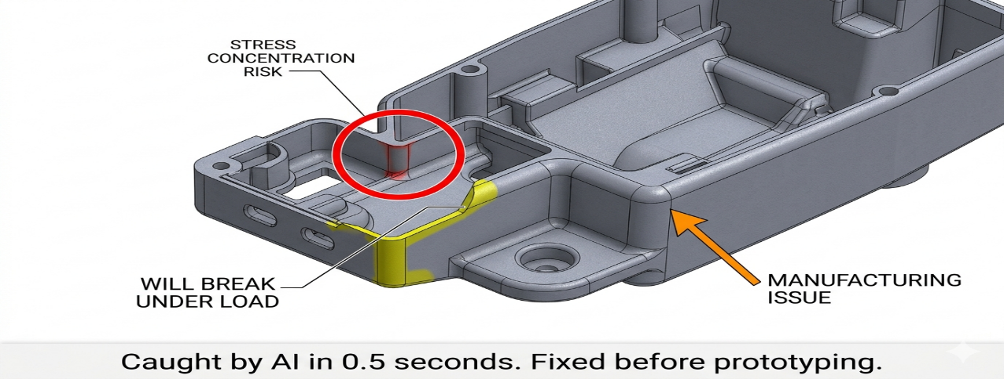
Business Potential
MARKET SIZE
📊 Scalability & Resource Optimization
80% less review time per project (200 hrs → 40 hrs)
3x more projects per engineer per year (4 → 12)
$180k productivity gain per engineer annually
Do more with same team – no extra hiring needed
Global CAD market: $10.4B by 2026
5M+ mechanical engineers worldwide
50,000 target customers (India)
REVENUE MODEL
SaaS: $50/user/month
Enterprise: $20k/company/year
Target Year 3: $30M
KEY METRICS
PROJECTED REVENUE
Break-even: Month 8
ROI for customer: 50x
LTV/CAC ratio: 9x (healthy >3x)
DEMAND VALIDATION
89% design teams face compliance issues
70% defects reach prototyping → 10x cost
Zero real-time AI competitors → BLUE OCEAN
🔍 Early Risk Detection & Prevention
Detects stress risks before failure
Flags manufacturing issues proactively
0.5 seconds vs. days – AI speed
Fixed before prototyping – no rework delays
⏱️ 80% less review time | 📈 3x more projects per engineer | 💰 $180k productivity gain | 👥 Same team | 🔄 Zero rework.

Slide 7
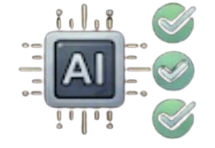


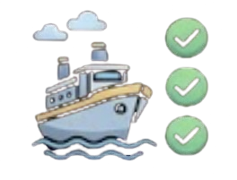

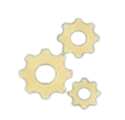
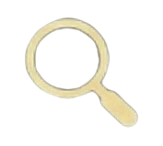

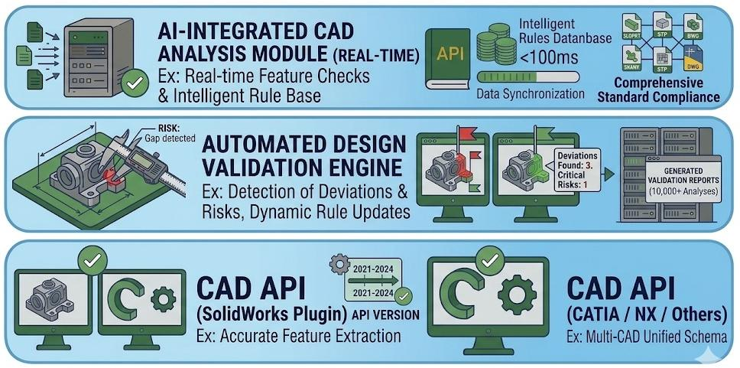
Plan And Budget Needed
DEVELOPMENT PHASES (Estimated)
BUDGET ESTIMATED (Prototype)
CAD Phase 1 – Core Setup
Plugin + API connection
Basic geometry extraction
10–15 design rules implemented
Phase 2 – Validation Engine
Rule-based violation detection
Backend deployment
Report generation
Category | Estimated Cost
Cloud services (AWS) | 10,000 – 15,000
CAD software (trial/free) | 0
Development tools | 0
UI/assets | 2,000 – 5,000
Contingency | 5,000
TOTAL ESTIMATE | 17,000 – 25,000
Phase 3 – AI Integration
ML model training
Real-time suggestions
UI polish & testing
Phase 4 – Pilot Ready
Beta version for testing
Customer feedback integration
Production readiness
“Timeline depends on team size & resources”
Stage 1: Planning
Stage 2: Building
Stage 3: Testing
Stage 4: Achieved
“Actual costs may vary based on requirements”
BUILD
TEST
ACHIVED
PLAN
⚙️ SolidWorks API
integration.
⚙️ Spring Boot backend
⚙️ Rule-based
validation system
🏆 Working prototype
🏆 Real-time CAD
Validation
🏆 Demo ready for
Eureka.
📋 CAD plugin
architecture
📋 Backend API design
📋 20+ design rules mapped
🔍 Violation detection
🔍 Report generation
🔍 Performance tuning

